Slide 1
30 Days of Gratitude Toolkit

Slide 2
CHOOSE LOVE IS CELEBRATING GRATITUDE THIS MONTH!
What is Gratitude?
Gratitude is defined as the feeling or expression of thankfulness and appreciation toward yourself, others, people, places, or things.
Get a Gratitude Poster for your home, class, or office here!
EVERY DAY WE WILL BE POSTING TIPS TO HELP YOU REAP THE BENEFITS OF PRACTICING GRATITUDE.

Slide 3
FOLLOW & TAG US
Facebook
@JLChooseLove
Twitter
@ScarlettMLewis
Instagram
@chooselovemovement
TikTok
@chooselovemovement
#30DAYSOFGRATITUDE
#CHOOSELOVEMOVEMENT

Slide 4
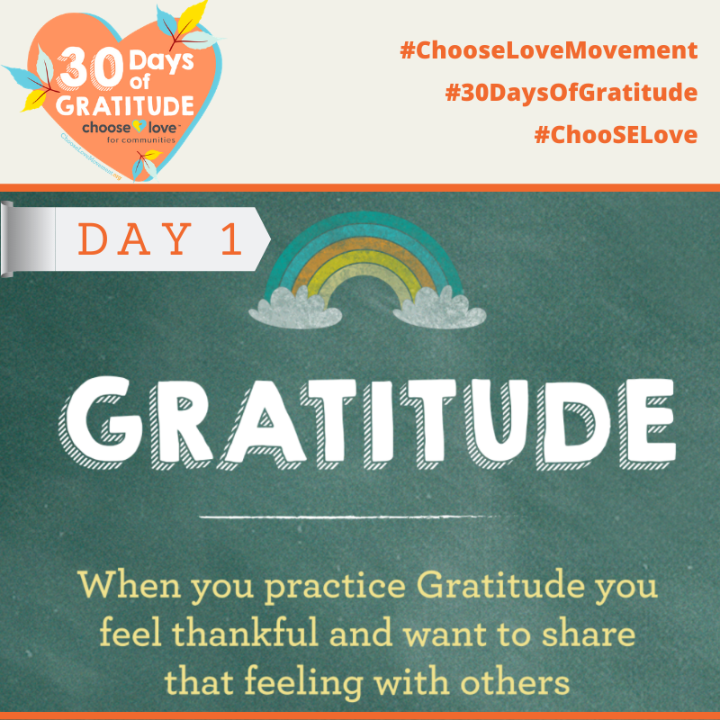
Sunday, Nov 1st
What is Gratitude?
Welcome to Choose Love's #30DaysOfGratitude 2020 campaign! Every day we will be posting tips that will help you reap the benefits of practicing #gratitude. Let's start the month off by re-learning exactly what gratitude is in the simplest of terms.
#ChooseLoveMovement #30DaysOfGratitude #ChooSELove
Save Image

Slide 5
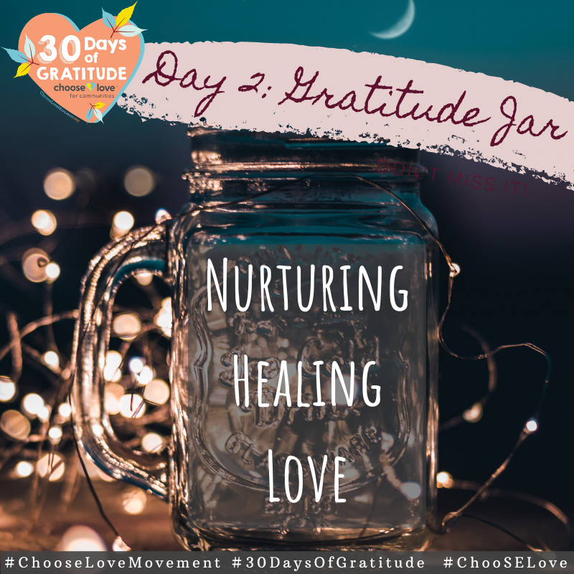
Monday, Nov 2nd
Gratitude Jar
One of the emotional benefits of practicing gratitude is that you will be less envious of what others have. Make a gratitude jar and every day this month think of what you were most grateful for that day. Write it down in a journal and try to put $1 or whatever you can in the jar. Then, at the end of the month, take the amount you saved and donate it to a cause you believe in for #GivingTuesday, like the Choose Love Movement.
#ChooseLoveMovement #30DaysOfGratitude #ChooSELove
Save Image

Slide 6
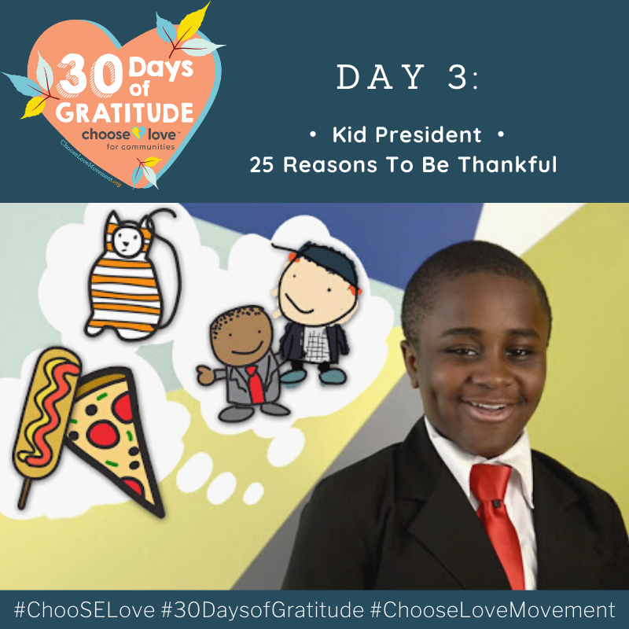
Tuesday, Nov 3rd
Kid President
Another emotional benefit of practicing gratitude is that you will have happier memories! Things as simple as pants, cake for no reason, or even the sound of Morgan Freeman's voice can bring you joy. Get inspired by Kid President's list of things he's grateful for - make your own list and think of all the great memories you have attached to the items on that list.
#ChooseLoveMovement #30DaysOfGratitude #ChooSELove
Save Image

Slide 7
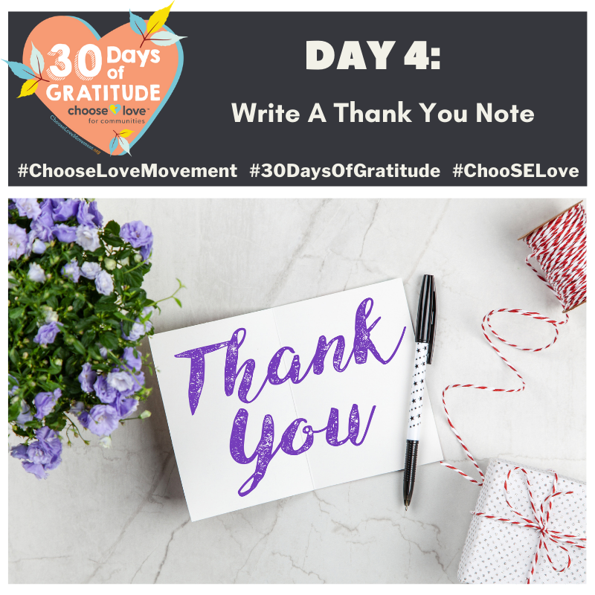
Wednesday, Nov 4th
Write a Thank You Note
Think about someone in your life who has brought you happiness and reflect on how they have brightened your life. Write a note, thanking them for all that they've done for you. Take a picture of the note to remind yourself not to take that person for granted. By expressing your gratitude, you are deepening your relationship with this person.
#ChooseLoveMovement #30DaysOfGratitude #ChooSELove
Save Image

Slide 8
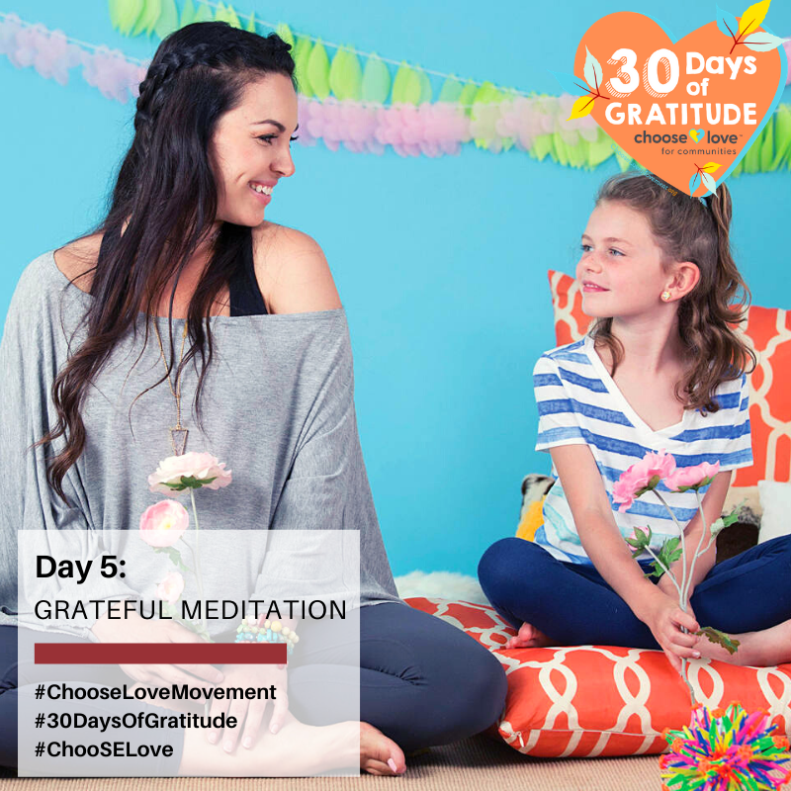
Thursday, Nov 5th
Guided Grateful Meditation
Find a comfy and quiet space where you can focus and follow along with this guided meditation led by Tania Joy Antonio, author of The Affirmation Station. By doing a grateful meditation and looking inward to find things you like about yourself, you can boost your self-esteem and have a happy, healthy, grateful heart.
#ChooseLoveMovement #30DaysOfGratitude #ChooSELove
Save Image

Slide 9
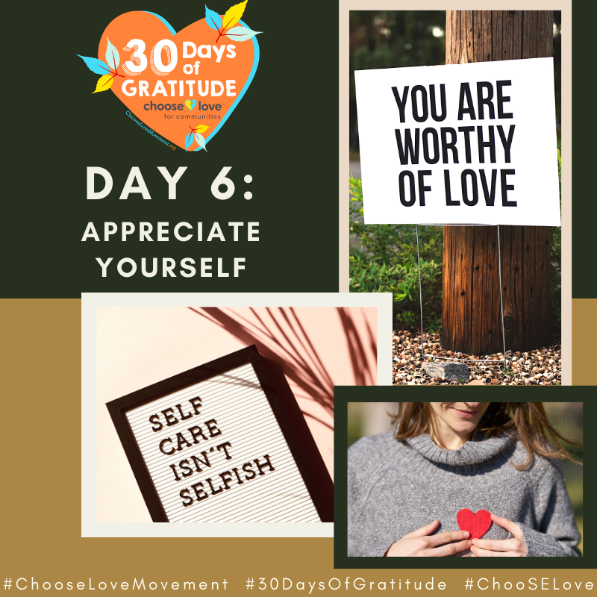
Friday, Nov 6th
Appreciate Yourself
Think about 3 things you love about yourself. Write down each appreciation on its own sticky note. Place the notes on your wall, mirror or another surface. Read each note out loud 3 times. Although it may seem odd, reminding yourself about the amazing qualities you possess is highly beneficial for your mental health. Positive affirmations help you cope with stress, improve your mood, and serve as motivation. You are more than your flaws, so take the time to reflect on your best qualities.
#ChooseLoveMovement #30DaysOfGratitude #ChooSELove
Save Image

Slide 10
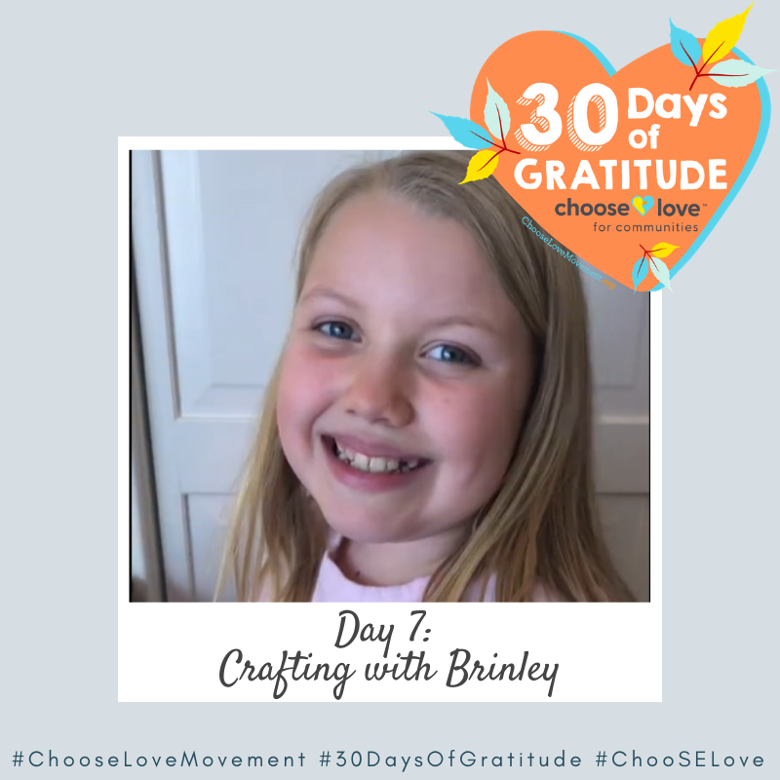
Saturday, Nov 7th
Crafting with Brinley
Brinley teaches us how important our thoughts are with this fun gratitude craft. She shows us how when we focus on grateful thoughts, we can change our mindset for the better. By being mindful of gratefulness, we can increase our energy and improve our health!
#ChooseLoveMovement #30DaysOfGratitude #ChooSELove
Save Image

Slide 11
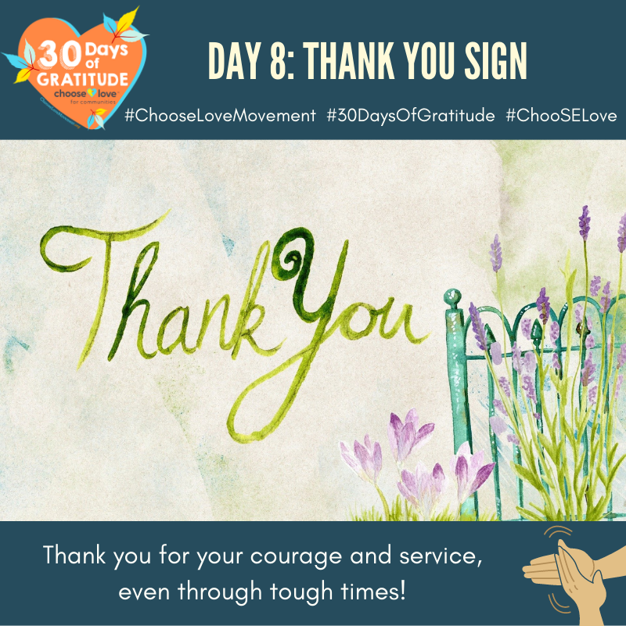
Sunday, Nov 8th
Create a Thank You Sign
Show your appreciation for essential workers who work hard to make sure we stay safe, healthy and keep our daily lives moving along. Write down an expression of gratitude for these people and then get creative with your sign. Place the sign in a window so others can see it as they pass your home, office, or classroom. By practicing gratitude, you will feel better and more optimistic!
#ChooseLoveMovement #30DaysOfGratitude #ChooSELove
Save Image

Slide 12
This Week’s Recap
Stay Tuned For Next Week’s Tips!

Slide 13
FOLLOW & TAG US
Facebook
@JLChooseLove
Twitter
@ScarlettMLewis
Instagram
@chooselovemovement
TikTok
@chooselovemovement
#30DAYSOFGRATITUDE
#CHOOSELOVEMOVEMENT

Slide 14
Email
Director of Advocacy: Shannon.M.Desilets@nh.gov
General: info@jesselewischooselove.org
Get in touch
Website
FOR INQUIRIES, FEEDBACK, SUPPORT, OR JUST TO SAY HI!
www.ChooseLoveMovement.org
Donate
Text ChooseGratitude to 41444

